Slide 1
Nested Loops

Slide 2
Nested Loop
A nested loop means a loop statement inside another loop statement. That is why nested loops are also called “loop inside loops“. We can define any number of loops inside another loop.

Slide 3
Nested For Loop
Nested for loop refers to any type of loop that is defined inside a ‘for’ loop.

Slide 4
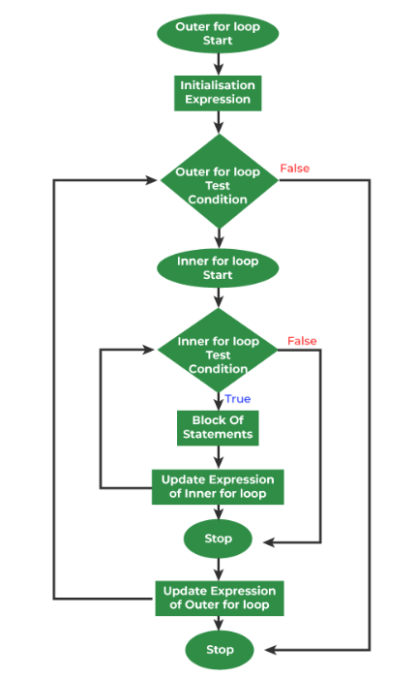

Slide 5
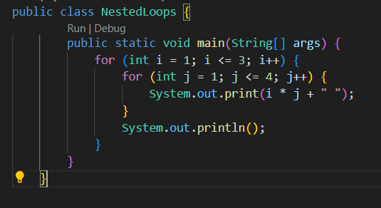
Java

Slide 6
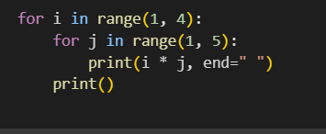
Python

Slide 7
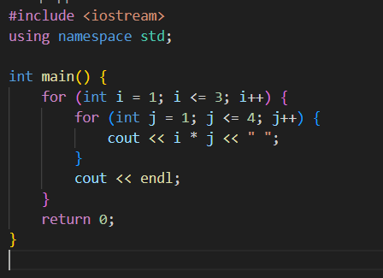
C++

Slide 8
Nested While Loop
A nested while loop refers to any type of loop that is defined inside a ‘while’ loop.

Slide 9
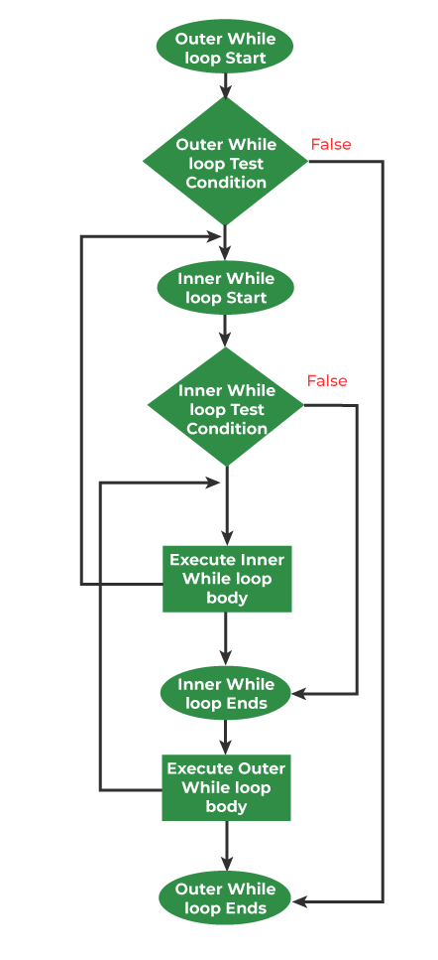

Slide 10
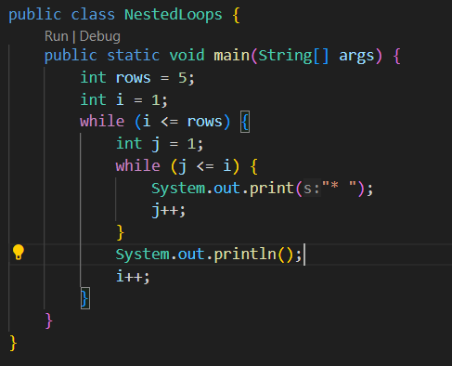
Java

Slide 11
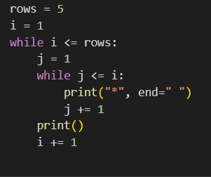
Python

Slide 12
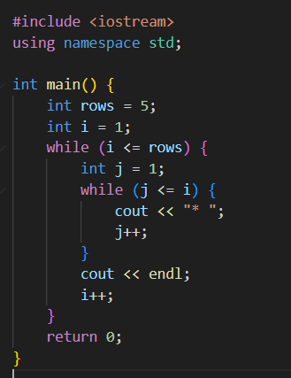
C++

Slide 13
Task
Write a program that takes a number as input from the user and prints a right angle triangle with that many rows using asterisks. For example, if the user inputs 5.
Write a program that takes a number as input from the user and prints an inverted right angle triangle with that many rows using asterisks.
Write a program that takes a number as input from the user and prints a pyramid with that many rows using asterisks.
Write a program that takes a number as input from the user and prints a diamond shape with that many rows using asterisks.
Write a program that takes a number as input from the user and prints a hollow square with that many rows and columns using asterisks.

